Slide 1
Digital System Design
Slide - 4

Slide 2
Sequential Circuits
Systems in practice includes memory elements
Consists of a combinational circuit to which storage elements are connected to form a feedback path
Binary information stored in the memory elements at any given time defines the state
Inputs, together with the present state of the memory elements determine the binary value at the output and condition for changing the state
Thus, specified by a time sequence of inputs, outputs and internal states

Slide 3
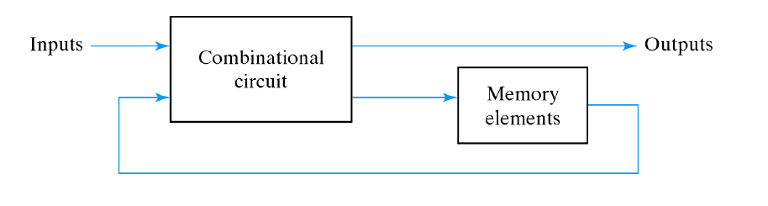
Sequential Circuits (Contd.)
Fig: Block Diagram of a Sequential Circuit

Slide 4
Sequential Circuits (Contd.)
Two types based on the timing of their signals:
Asynchronous sequential circuit
Depends upon the input signals at any instant of time and the change order of the signals
May have better performance but hard to design, not commonly used
Has state that is not synchronized with a clock, rather uses a time-delay device
Synchronous sequential circuit
Defined from the knowledge of its signals at discrete instants of time
Much easier to design (preferred design style)
Synchronized by a periodic train of clock pulses
Memory elements in a clocked sequential circuit are flip-flops

Slide 5
Register
A register is a group of binary storage cells suitable for holding binary information. A group of flip flops constitutes a register, since each flip-flop is a binary cell capable of storing one bit of information. An n-bit register has a group of n flip-flops and is capable of storing any binary information containing n-bits.

Slide 6
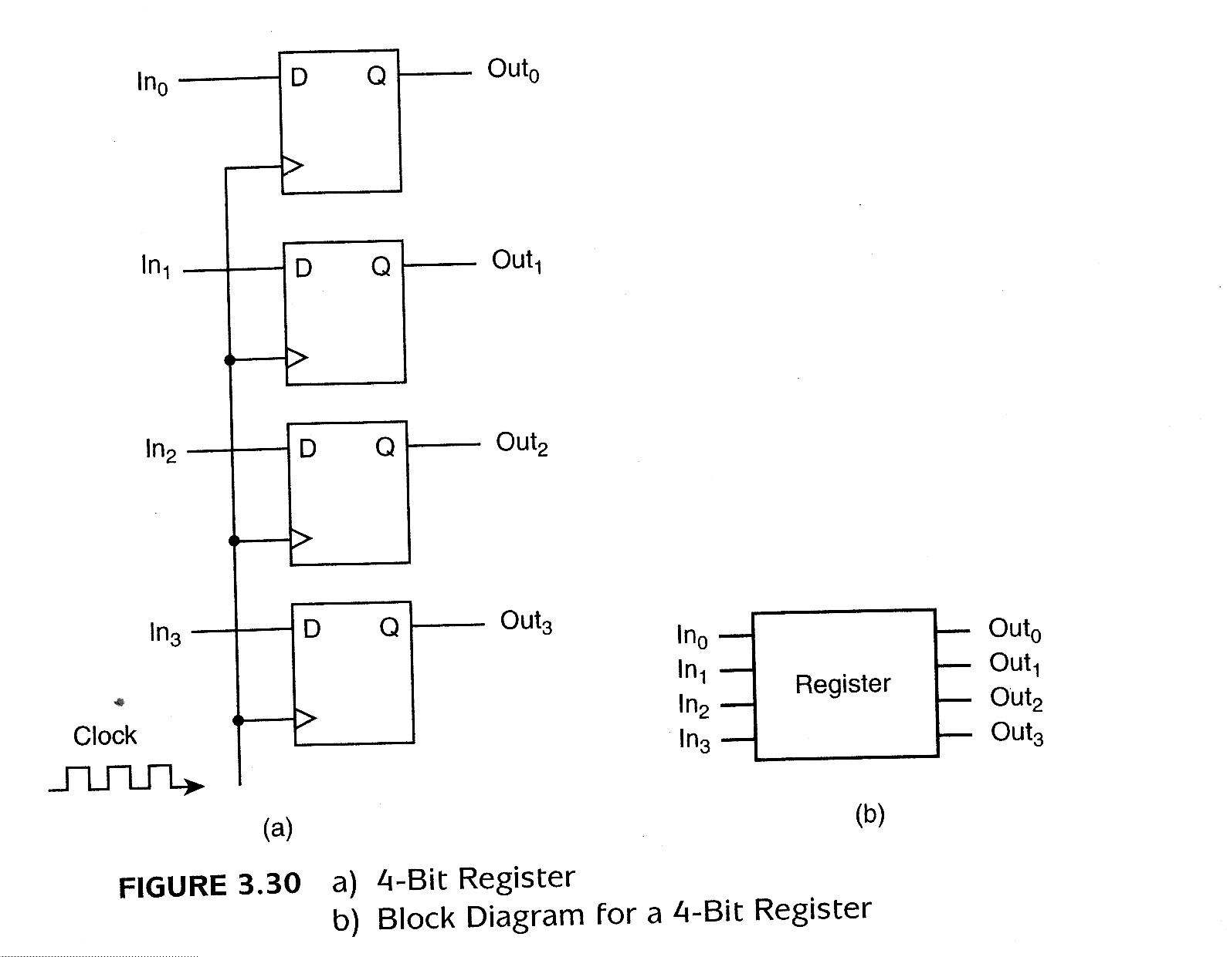
Register (Contd.)
Register is enabled as long as cp=1.
When cp=1, the input info is loaded into the register.
If cp remains at 0, the content of the register is not changed.

Slide 7
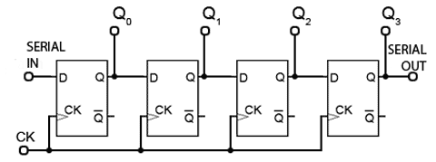
Shift Register
A register capable of shifting its binary info either to the left or to the right is called a shift register. The logical configuration of a shift register consists of a chain of flip-flops connected in cascade, with the output of one flip-flop connected to the input of the next flip-flop. All flip-flops receive a common clock-pulse which causes the shift from one stage to the next.
Fig: Shift Register (SISO)

Slide 8
Serial Transfer Using Shift Register
A digital system is said to operate in a serial mode when information is transferred and manipulated one bit at a time.
The information is transferred one bit at a time by shifting the bits out of the source register into the destination register.

Slide 9
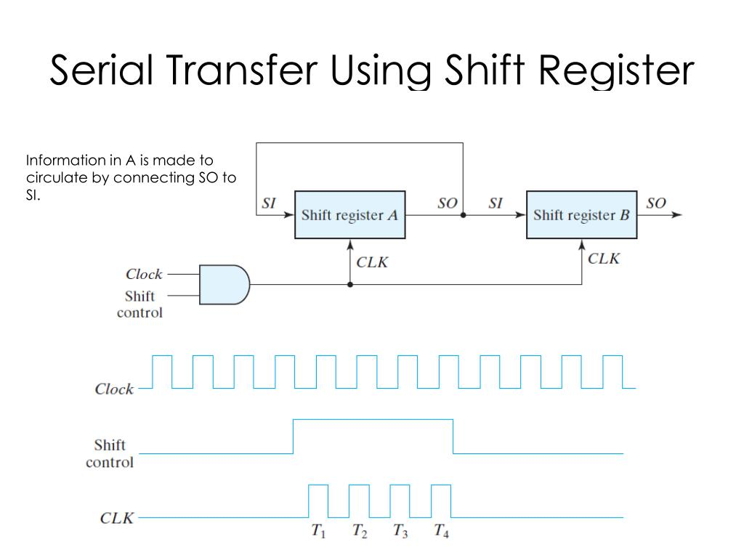
Serial Transfer Using Shift Register (Contd.)
Suppose the shift registers have 4 bits each.
The shift control input determines when and by how many times the registers are shifted.
Fig: Serial Transfer using Shift Register

Slide 10
Serial Transfer Using Shift Register (Contd.)
Timing Pulse | Shift Register A | Shift Register B | Serial output of B
Initial Value | 1 0 1 1 | 0 0 1 0 | 0
After T1 | 1 1 0 1 | 1 0 0 1 | 1
After T2 | 1 1 1 0 | 1 1 0 0 | 0
After T3 | 0 1 1 1 | 0 1 1 0 | 0
After T4 | 1 0 1 1 | 1 0 1 1 | 1
After the 4th shift, the shift control goes to 0 and both registers A and B have same value of 1011.

Slide 11
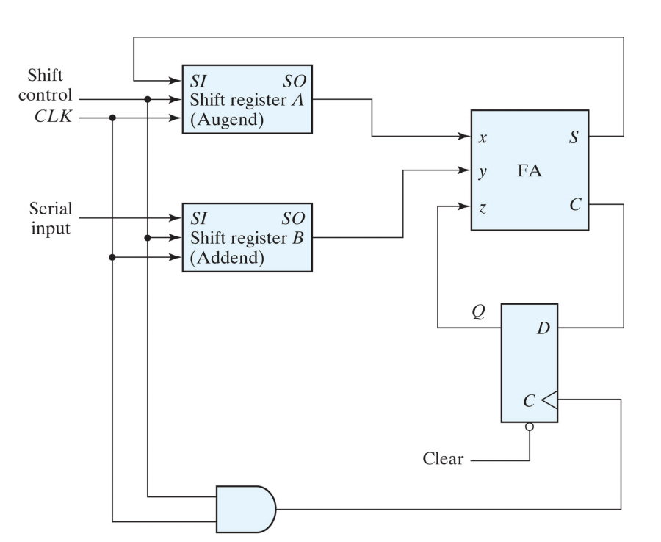
Serial adder Implementation with Shift Register
Ques: In which aspects a serial adder is different compared to a parallel adder?
Fig: Serial Adder Implementation using Shift Register

Slide 12
Practice Questions
Differences between Asynchronous and Synchronous Sequential Circuits
Design a 3-bit binary counter using J-K flip flops.
Design a 4-bit BCD/binary counter.
Design a synchronous counter using different types of flip flops.
Design a mod 5 counter using different types of flip flops.
Design a counter with a repeated binary sequence using different types of flip flops.
Design a n-bit Up/Down counter using different types of flip flops.
Design an odd/even counter using different types of flip flops.

